Slide 1
POWER BI WORKSHOP
27ª Semana da Engenharia Química

Slide 2
Agenda
Apresentação
Carregar Dados
02
04
01
03
Explorar a ferramenta
Tratamento de Dados
Construir Visualizações
05

Slide 3

PALESTRANTES
22 anos
Ciência da Computação (Unicamp)
+3 anos de experiência (Ambev)
Certified PL-300/DP-900 (Microsoft)
Dunamis Pockets Unicamp
OCTÁVIO NASCIMENTO

Slide 4

PALESTRANTES
21 anos
Data Tech Lead Ambev
Gestão de TI – Fatec Campinas
Eng. Comp – Universidade de Franca (cursando)
MBA Data Science – USP (cursando)
Adoro uma cervejinha e conhecer novos lugares
BEATRIZ RODRIGUES

Slide 5
Explorando a Ferramenta

Slide 6
CONTENTS OF THIS TEMPLATE
Here’s what you’ll find in this Slidesgo template:
A slide structure based on a consulting sales pitch, which you can easily adapt to your needs. For more info on how to edit the template, please visit Slidesgo School or read our FAQs.
An assortment of illustrations that are suitable for use in the presentation can be found in the alternative resources slide.
A thanks slide, which you must keep so that proper credits for our design are given.
A resources slide, where you’ll find links to all the elements used in the template.
Instructions for use.
Final slides with:
The fonts and colors used in the template.
More infographic resources, whose size and color can be edited.
Sets of customizable icons of the following themes: general, business, avatar, creative process, education, help & support, medical, nature, performing arts, SEO & marketing, and teamwork.
You can delete this slide when you’re done editing the presentation.

Slide 7
TABLE OF CONTENTS
01
02
03
PROBLEM & SOLUTION
OUR PROCESS
TARGET
Here you could describe the topic of the section
Here you could describe the topic of the section
Here you could describe the topic of the section

Slide 8
UNDERSTANDING THE PROBLEM
MARS
VENUS
Despite being red, Mars is a cold place. It’s full of iron oxide dust, which gives the planet its reddish cast
Venus has a beautiful name and is the second planet from the Sun. It’s terribly hot, even hotter than Mercury

Slide 9
OUR SOLUTIONS
MARS
NEPTUNE
JUPITER
SATURN
Despite being red, Mars is a cold place
It’s the farthest planet from the Sun
It’s the biggest planet in the Solar System
Saturn is the ringed one and a gas giant

Slide 10
MAIN COMPETITORS
NEPTUNE
MARS
VENUS
SATURN
It’s the farthest planet from the Sun
Despite being red, Mars is a cold place
Venus is the second planet from the Sun
It’s composed mostly of hydrogen and helium

Slide 11
COMPANY
01
You could enter a subtitle here if you need it

Slide 12
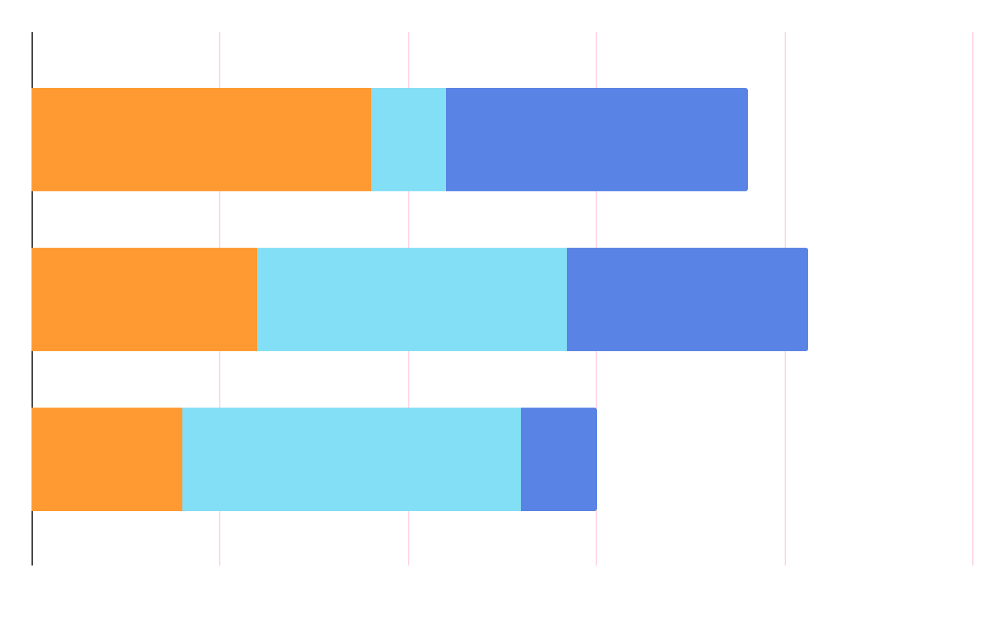
MARKET RESEARCH
NEPTUNE
MERCURY
SATURN
It’s the farthest planet from the Sun
Mercury is the closest planet to the Sun
Saturn is composed of hydrogen and helium

Slide 13
ANALYSIS
OUTREACH
TOP RATED VALUES
30%
80%
50%
Mars
Mercury
Saturn
Neptune
Venus

Slide 14
TARGET
GENDER
AGE
20-39
80%
40-60
50%
75%
Female
500,000+
Employees
60%
Male

Slide 15

A Picture Is Worth a Thousand Words

Slide 16
AWESOME WORDS

Slide 17


OUR CONSULTANTS
HELENA PATTERSON
JANE DOE
You can replace the image on the screen with your own
You can replace the image on the screen with your own

Slide 18
—SOMEONE FAMOUS
“This is a quote. Words full of wisdom that someone important said and can make the reader get inspired.”

Slide 19
OUR PARTNERS
VENUS
MARS
SATURN
MERCURY
Venus has an extremely poisonous atmosphere
Despite being red, Mars is actually a cold place
Saturn is composed mostly of hydrogen and helium
Mercury is the closest planet to the Sun

Slide 20
TESTIMONIALS
—RYAN DIXON
—ALIYA FARLEY
—HENRY McKANE
—BILLY BROOKS
—LUCY JADE
—ROSE CLARK
“Mercury is the closest planet to the Sun and the smallest of them all”
“Venus has a beautiful name and is the second planet from the Sun”
“Jupiter is a gas giant and the biggest planet in the Solar System”
“Saturn is composed mostly of hydrogen and helium”
“The Sun is the star at the center of the Solar System”
“Neptune is the fourth-largest planet in the Solar System”

Slide 21
4,498,300,000
Big numbers catch your audience’s attention

Slide 22
AWARDS
 | DATE | REASON | DESCRIPTION
MERCURY | 2010 | Jupiter | It’s the closest planet to the Sun and the smallest one
MARS | 2012 | Neptune | Despite being red, Mars is actually a cold place
VENUS | 2016 | Saturn | It has a nice name and is the second planet from the Sun

Slide 23
UPCOMING GOALS
JUPITER
SATURN
NEPTUNE
JUNE 2
OCTOBER 14
JANUARY 23
It’s the biggest planet in the Solar System
Saturn is composed mostly of hydrogen and helium
Neptune is the farthest planet from the Sun

Slide 24
Referências
Microsoft Power BI
Download Power BI Desktop <https://www.microsoft.com/pt-br/power-platform/products/power-bi/downloads>
Datasets
UFO Sightings - Table containing 80,000+ records of UFO sightings between 1949 and 2014 <https://mavenanalytics.io/data-playground?page=12&pageSize=5>

Slide 25
OBRIGADA
Ficou com alguma duvida?
Octavio - linkedin.com/in/octavioabn
Beatriz - linkedin.com/in/beatrizmsrodrigues

Slide 26
ALTERNATIVE RESOURCES

Slide 28
JANUARY
FEBRUARY
MARCH
APRIL
MAY
JUNE
PHASE 1
Task 1
Task 2
PHASE 2
Task 1
Task 2
JANUARY
FEBRUARY
MARCH
APRIL
PHASE 1
Task 1
Task 2

